Slide 1
Week 6
PHY495: Hoop Never Misses

Slide 2
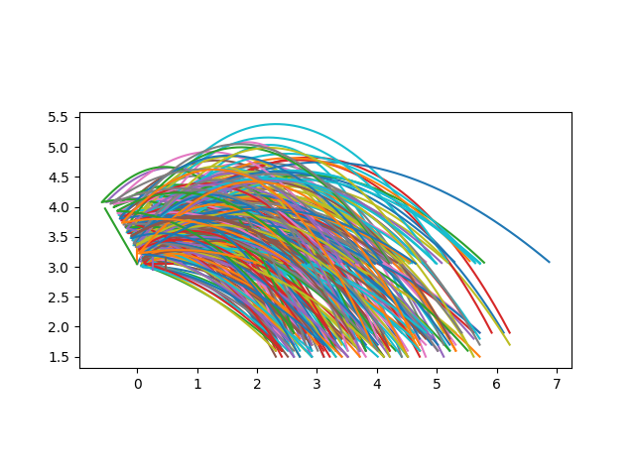
What I’ve Done
Percent in: 0.0 Angle: 1.0471975511965976
Percent in: 0.22448979591836735 Angle: 1.5707963267948966
Percent in: 0.09375 Angle: 2.0943951023931953

Slide 3
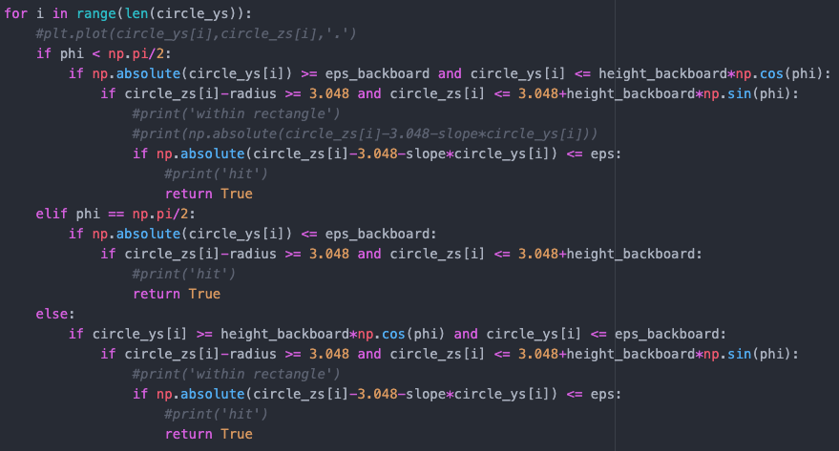
What I’ve Done
Found that some balls were hitting the bottom edge of the backboard and (if the backboard was angled backwards) would rebound up and could go in the basket. So I added the condition that at least the centre of the basketball has to hit the bottom edge (can’t be the top edge of the ball).

Slide 4
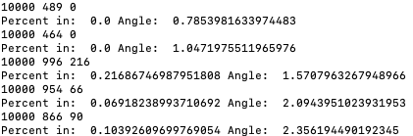
What Worked
Ga,f’dlask

Slide 5
What Didn’t Work

Slide 6
Where am I Stuck

Slide 7
What Next?

